Slide 1
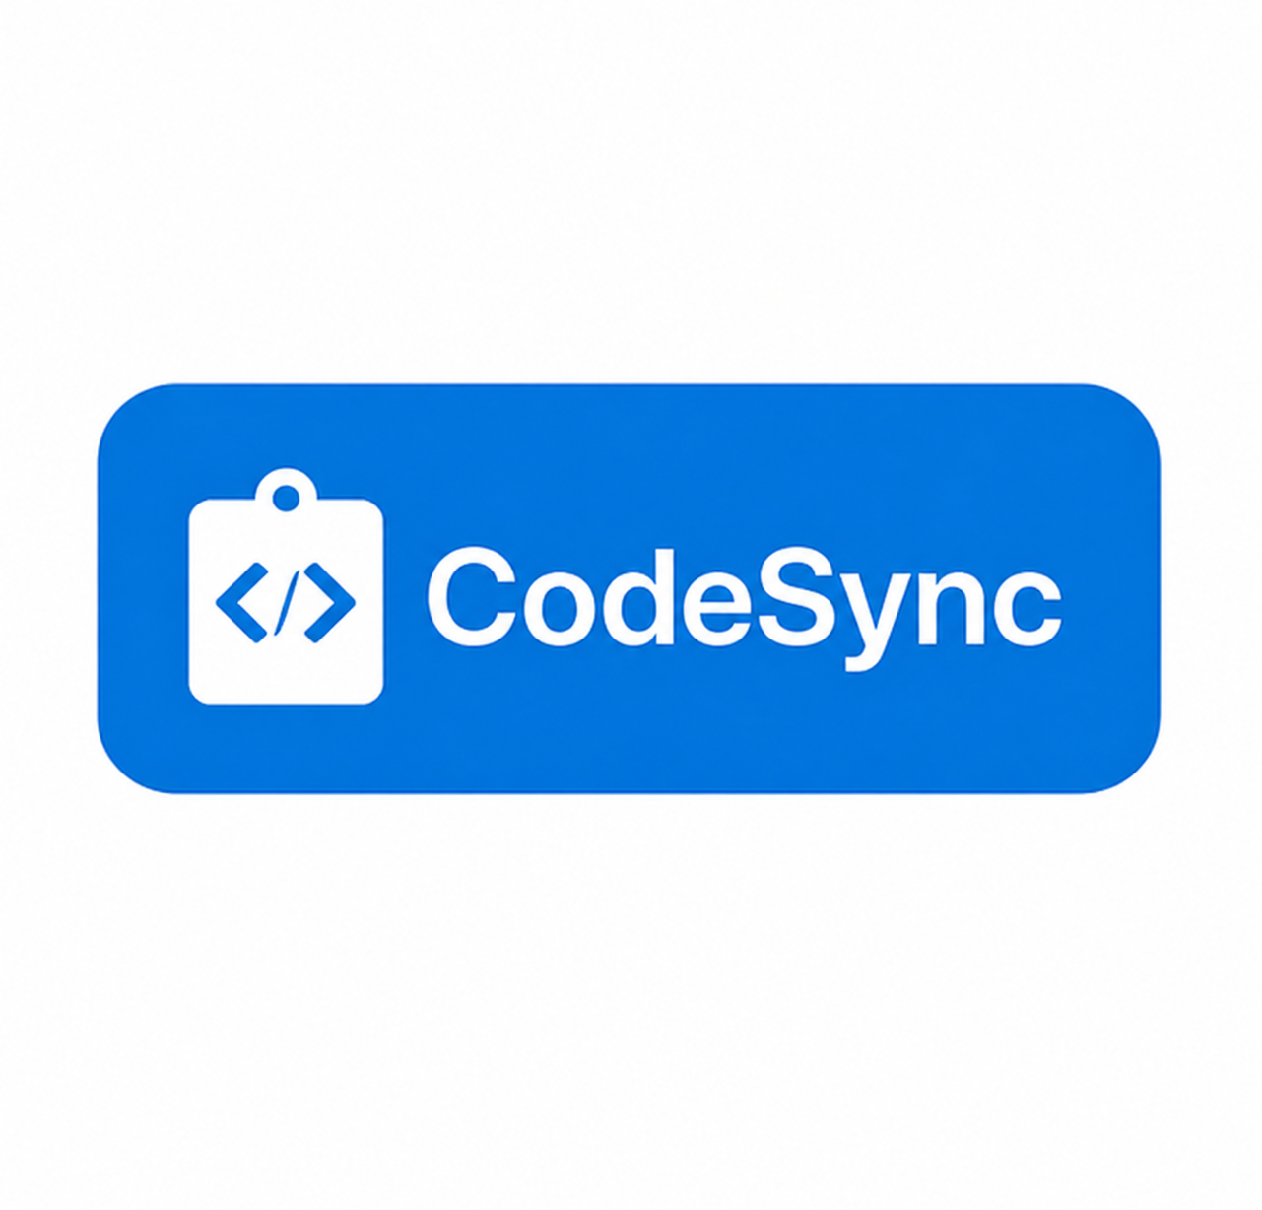
Name :- Jai Kumar Goel (2210991693) Ishika Goel (2210991690) Kavita (2210991774)
Project Presentation of CO-OP Project at Industry (Module-2) (22CS421)
On
Title – CodeSync
Collaborate. Code. Connect.
Submitted to :- Dr. Preeti Saini

Slide 2
Content
Introduction/Summary
Info About Platform
Problem Statement
Objective
Technology Stack
Module Overview
Collaborative Code Editor
Result
Future Scope
References

Slide 3
Summary
CodeSync is a real-time online code collaboration platform designed to simplify and enhance collaborative software development. The platform enables multiple users to simultaneously write, edit, and preview code with live cursor tracking, shared terminal execution, and instant UI rendering. Built using a modern tech stack—Next.js, TypeScript, Tailwind CSS, Monaco Editor, and Socket.IO—CodeSync emphasizes responsiveness and user experience. It integrates peer-to-peer video and voice chat using WebRTC (simple-peer), and offers a collaborative notepad for markdown-based documentation. GitHub API integration allows users to fetch and save files directly from public repositories without requiring authentication. The platform operates on a client-server model optimized for low latency and does not require user sign-up, making it ideal for pair programming, technical interviews, online workshops, and remote team collaboration. The expected outcome is a fully functional, no-login, multi-featured coding environment that enhances productivity and teamwork across distributed teams.

Slide 4
Info about Platform
CodeSync
Software development by students, educators, and remote teams has become the new norm. In this environment, having robust collaborative tools for coding is essential for effective teamwork and productivity. While there are several online collaboration tools, most are limited to rich text editing and lack developer-focused features.
It offers a modern collaborative experience tailored for programmers. It allows users to collaboratively write and edit code in real-time, chat live, and even connect via video calls — all within a single room-based environment. It simplifies teamwork, especially in distributed setups such as coding bootcamps, online classes, and remote development teams.

Slide 5
Problem Statement
Lack of real-time collaborative coding tools with full-featured communication.
Most existing platforms focus on text editing, not code collaboration.
Developers need an integrated environment for live code, chat, and calls.
There is a lack of real-time collaborative coding tools that combine robust code editing with full-featured communication (voice/video).
Most existing platforms are limited to basic text editing, lacking features like shared terminal execution, UI preview, or GitHub integration.
Developers often have to use multiple tools simultaneously (e.g., VS Code Live Share, Zoom, and Slack), leading to context switching and inefficiency.
Many platforms require mandatory sign-ups or subscriptions, making them unsuitable for quick sessions like interviews, hackathons, or mentoring.

Slide 6
Objective
1. Real-Time Code Editing
Collaborative editor with syntax highlighting for multiple languages.
Auto-indentation, bracket matching, and code formatting.
Real-time cursor tracking to see other users’ edits instantly.
Multiple file/project support in a shared workspace.
Support for themes (light/dark mode).
2. Communication Tools
Live chat (text-based) integrated with the code editor.
Voice and video calls within rooms for direct communication.
Emoji reactions and inline comments for quick feedback.
Threaded discussions tied to specific lines of code.

Slide 7
3. Room & Session Management
Create rooms with unique, shareable links.
Password-protected rooms for private collaboration.
Temporary guest access without full registration.
Persistent room history and saved code sessions.
4. Developer Productivity Tools
Integrated terminal for running code in real time (sandboxed environment).
Support for multiple programming languages and runtimes.
Code execution results displayed in a shared console.

Slide 8
Technology Stack
Frontend
React.js – Core frontend framework for building the UI.
Tailwind CSS / Material UI – For responsive and modern UI components.
Monaco Editor (VS Code’s editor) or CodeMirror 6 – Real-time collaborative code editing with syntax highlighting.
React Router – For navigation between rooms, dashboard, and settings.
WebRTC – For peer-to-peer video/audio calls.
Socket.IO client – For real-time messaging and code synchronization.

Slide 9
Backend
Node.js – JavaScript runtime.
Express.js – Backend web framework for API endpoints.
Socket.IO server – Real-time communication between users.
WebRTC signaling server – For establishing video/audio connections.
JWT (JSON Web Tokens) – For authentication and authorization.

Slide 10
Collaborative Code Editor
Built using CodeMirror/Monaco Editor.
Real-time updates using Socket.IO.
Multiple users can edit code simultaneously.
Support for multiple languages with syntax highlighting.
Authentication: Signup/Login with validation
Editor: Real-time sync with operational transformation
Chat System: Live messaging with Socket.IO
Video Calls: Peer-to-peer media using WebRTC
Room Management: Create and invite others easily

Slide 11
Chat and Communication
Real-time chat built using Socket.IO.
Features: emojis, timestamps, typing indicator.
Separate chat section for each room.
WebRTC-based peer-to-peer video calling.
Built-in microphone and camera support.
Users can mute/unmute, toggle camera, or leave call

Slide 12
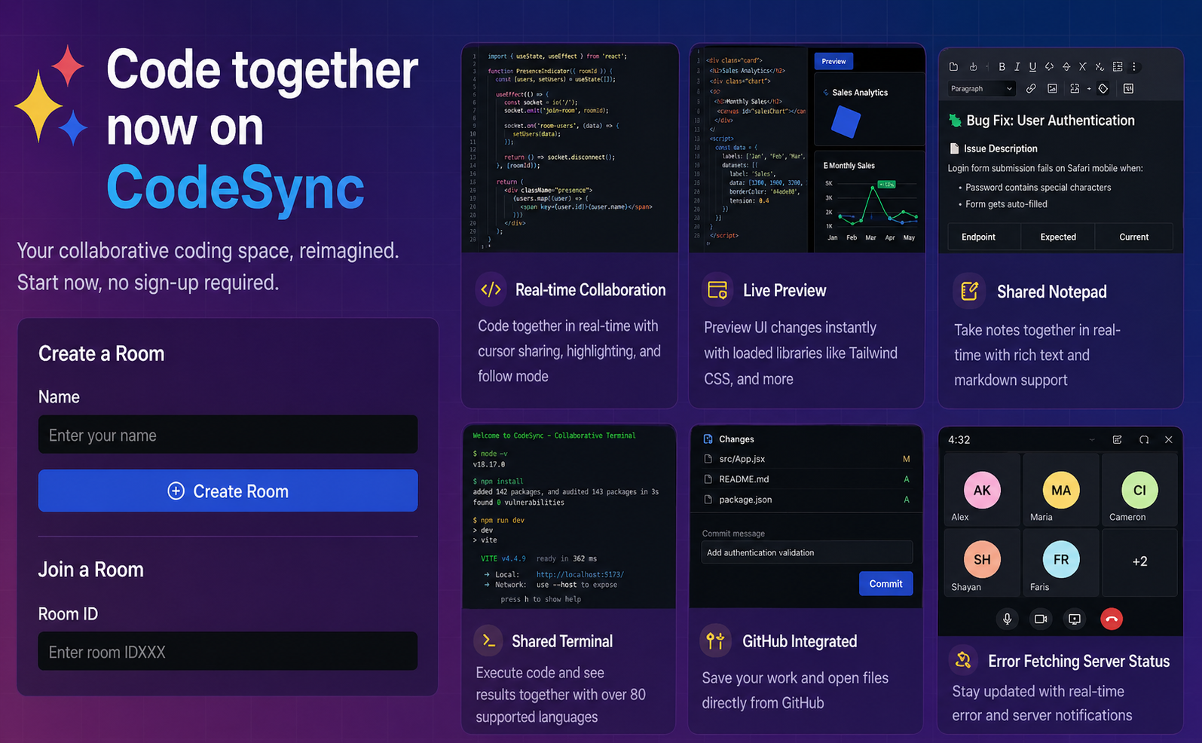
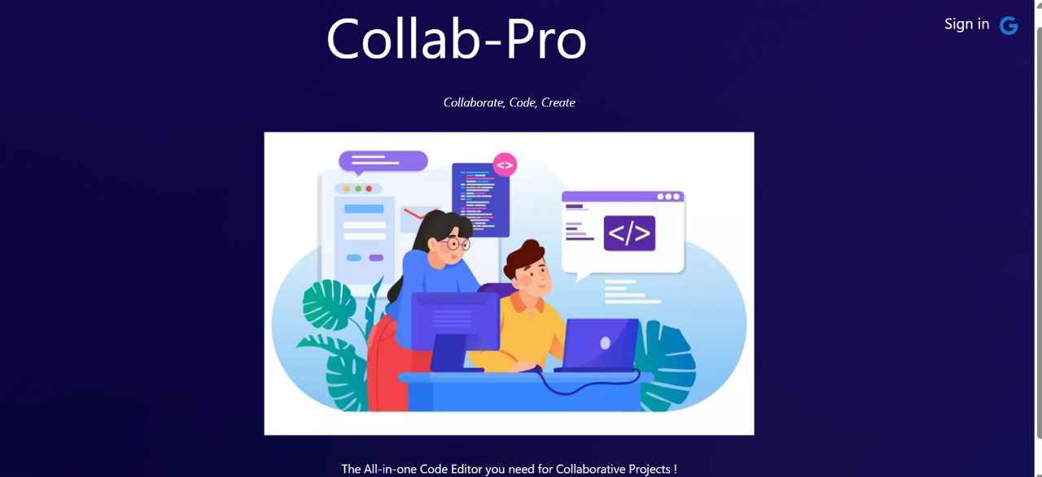

Result
Login to Pinogram
Username- ______
Password- _______
Login buttton

Slide 13
Future Scope
Large-scale software projects often involve a deeply nested and complex directory structure. Enhancing the CodeSync editor to support such structures can greatly improve its usability and developer experience.
CodeSync already offers a chat feature for seamless communication between users. Integrating advanced features like group threads, message history, and notifications will further enhance collaboration.
Introducing an online compiler and integrated terminal within the platform will enable users to test and execute code directly, streamlining the development process without switching contexts.
Adding Version Control System (VCS) support, such as Git, will empower developers to commit, push, fork, and manage their code repositories within the same interface, making CodeSync a complete development ecosystem.

Slide 14
References
MongoDB Official Website – https://www.mongodb.com/
Visual Studio Code (VS Code) – https://code.visualstudio.com/
GitHub – https://github.com/
CodeSandbox – https://codesandbox.io/

Slide 15

..

